Slide 1


Slide 2
Features
Spark module for structured data processing
Unit of processing is the Dataset or DataFrame
DataFrame is a Dataset having named columns
Data read and manipulated using SQL
Ability to read Hive data as well
High performance is achieved using the Catalyst engine
Notes:
Dataset is a collection of records.
Each record in the Hive table is a row. Dataset is a resilience distributed collections of rows where row is an object. row is Scala class

Slide 3
Load Data
val salesRecords =
spark.read.load("/Users/hadoop-user/Documents/SalesJan2009.parquet")
This loads a parquet file by default
The default option is specified by the configuration property “spark.sql.sources.default”
The default can be overridden by setting the parameter in the configuration object of the SparkSession
spark.conf.set("spark.sql.sources.default", "csv")

Slide 4
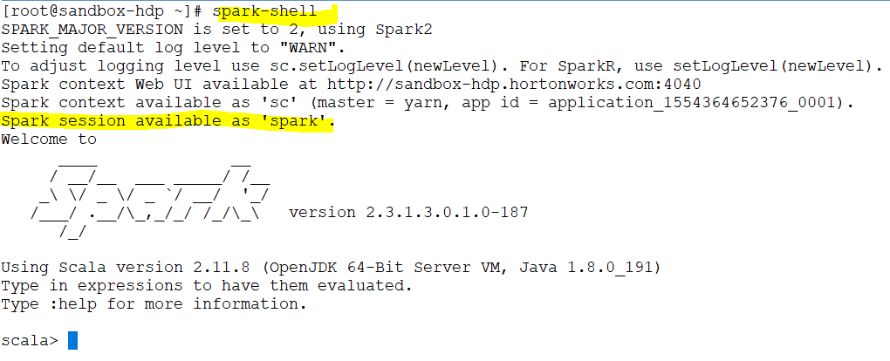
Notes:
We need to create spark session but in our case the spark session is created inside the spark shell.
Since the session has been created we can use that session to load our data
Lets try to load our dataset

Slide 5
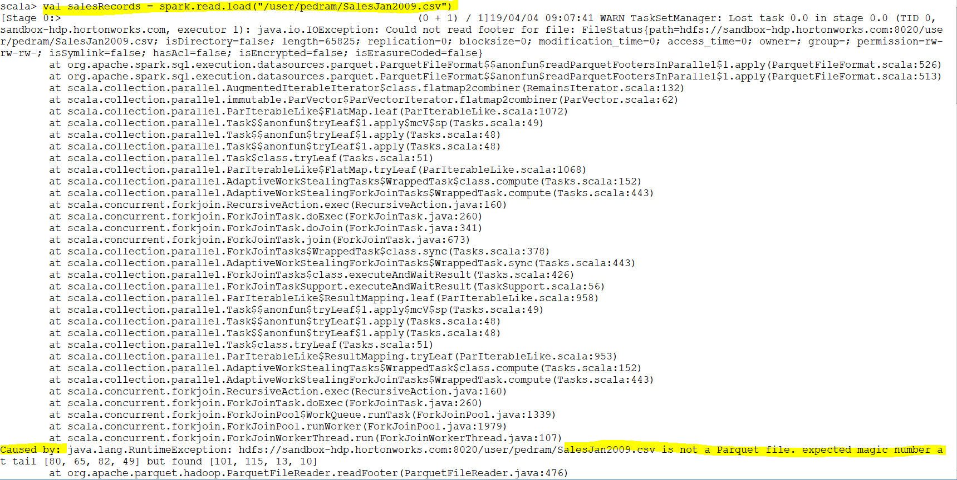
Notes:
Spark expected to have parquet file by default.
Parquet is a data source. json ,csv are another data source.
Read from parquet

Slide 6
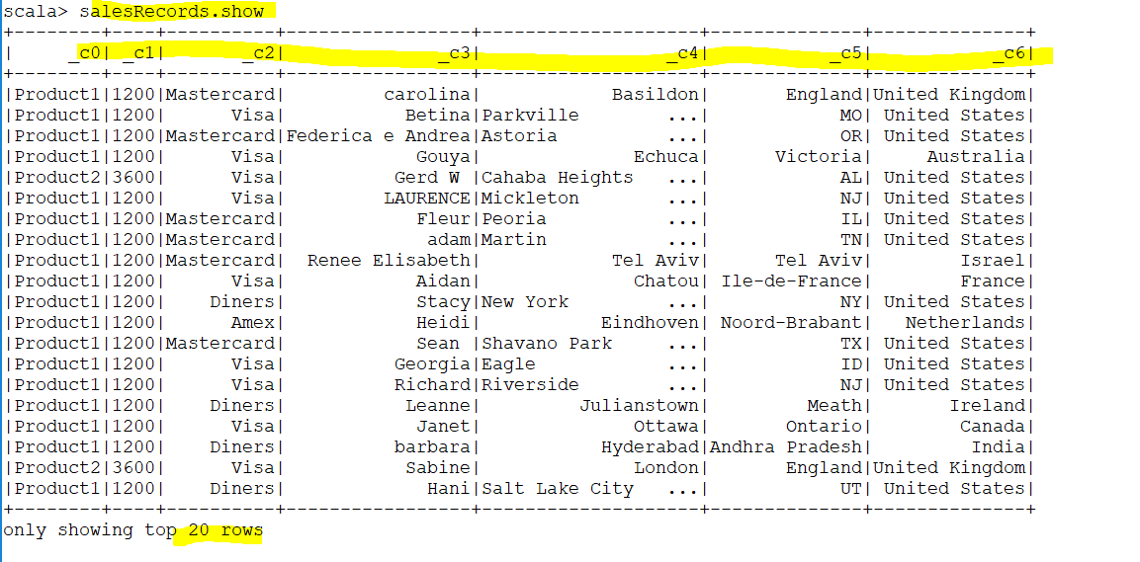
Notes:
There is a problem here as the header is taken as row (we will fix it)
Another way is set the spark conf
spark.conf.set("spark.sql.sources.default", "csv"

Slide 7
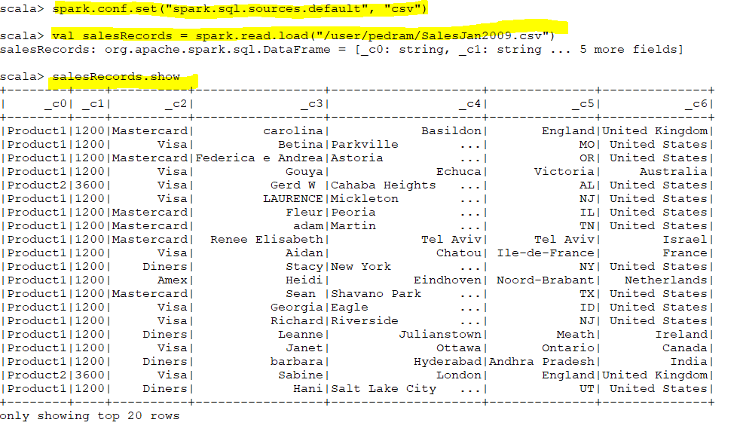

Slide 8
Load Data
An easier way to load various types of data, other than parquet, is using the following:
val salesRecords = spark
.read
.format(“csv”)
.load("/Users/hadoop-user/Documents/SalesJan2009.csv”)
The formats supported are json, parquet, jdbc, orc, csv and text
The formats are data sources and should be referred to using their fully qualified names like “org.apache.spark.sql.parquet”
The out-of-the-box supported data sources have short names like mentioned above - jdbc

Slide 9
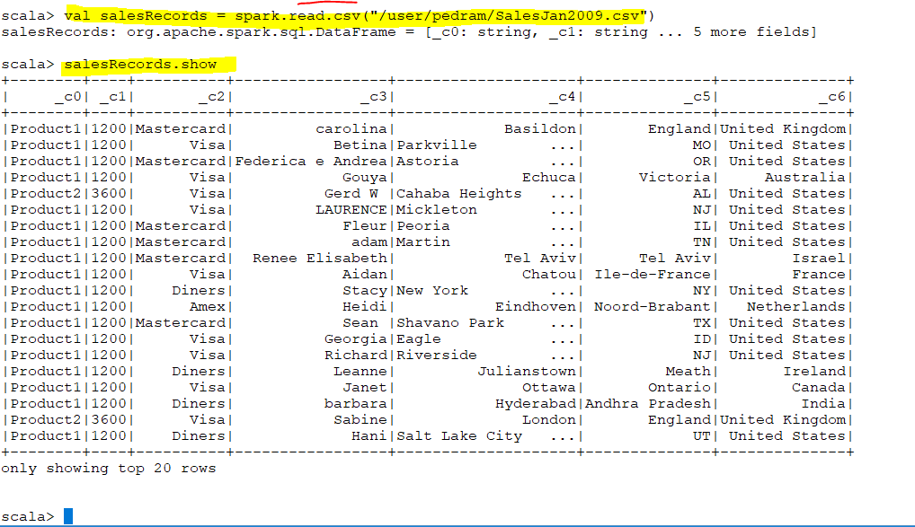
Notes:
Even there is a shorter format

Slide 10
https://spark.apache.org/docs/2.3.0/api/scala/#package
Notes:
https://spark.apache.org/docs/2.3.0/api/scala/#package

Slide 11
Load Options
Data sources have their own options that can be specified during the load process:
val salesRecords = spark.read.format("csv”)
.option("sep", ";")
.option("inferSchema", "true")
.option("header", "true”)
.load("/Users/hadoop-user/Documents/SalesJan2009.csv")
Note: While reading a csv file, the first row is always taken as the header, if the header option is set to true, as shown in the above example

Slide 12
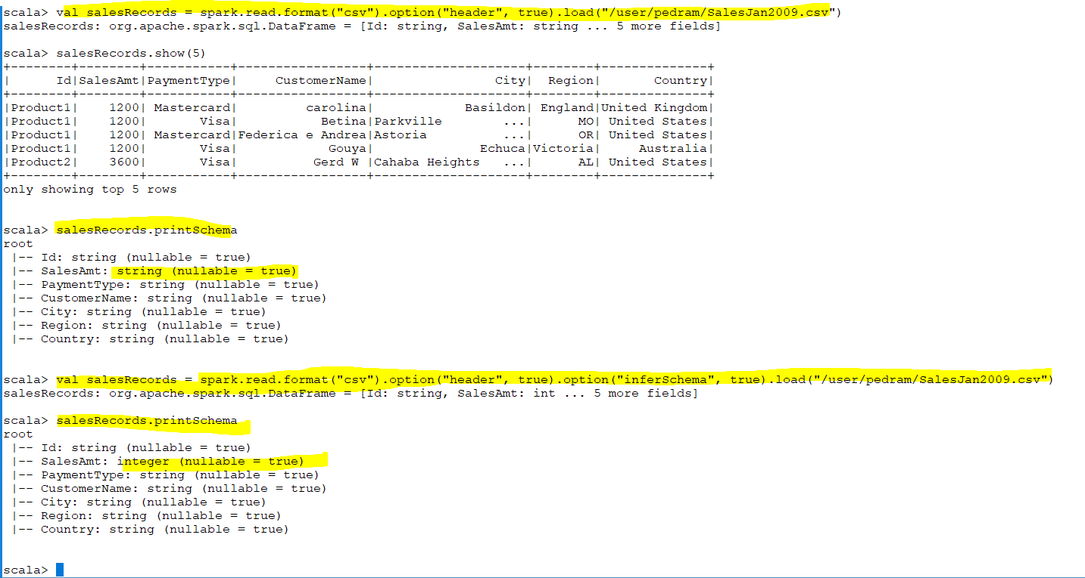

Slide 13
Reading Parquet Files
Parquet files can be read using:
spark.read.parquet(“path”)
If the base location of the table is specified as the path, the partitions are automatically discovered
Partition columns of numeric data types, date, timestamp and string types are automatically inferred
These columns are automatically inferred because the property “spark.sql.sources.partitionColumnTypeInference.enabled” is set to true by default
If the above property is set to false, all partition columns will be read as String
If different partitions have different schema, Spark can merge their schemas if the option “mergeSchema” is set to true
Spark caches hive metadata by default. Hence, it is necessary to refresh the metadata if there is a chance it being changed from outside.

Slide 14
Other Data Sources
ORC
JSON
Avro
JDBC
Text

Slide 15
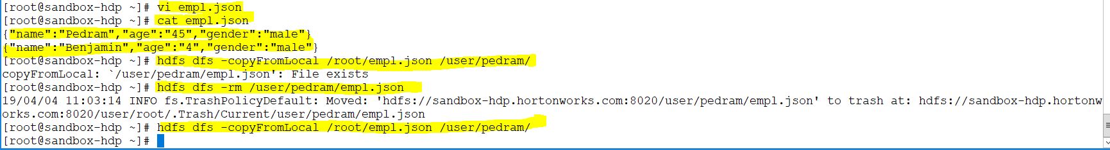
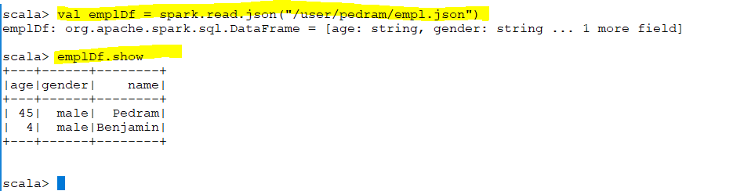
It has imported the schema by itself

Slide 16
Dataframe Operations
alias(String alias)
apply(String columnName)
cache (default level: MEMORY_AND_DISK)
coalesce(int numPartitions)
col(String colName)
collect
collectAsList
columns
count
createGlobalTempView
createOrReplaceGlobalTempView
createTempView
createOrReplaceTempView

Slide 17
Dataframe Operations
distinct
drop(Column col/String colName)
drop(String.. colNames)
dropDuplicates
dropDuplicates(String[] colNames)
except(Dataset other)
explain
filter(Column condition) //df.filter($”id” > 100) & df.filter(“id > 100”)
filter(function)
first
foreach(function)
foreachPartition(funstion)

Slide 18
Dataframe Operations
rdd
groupBy(Colomn col/String… cols)
head
intersect(Dataset other)
join(Dataset other)
union
limit(n)
map
mapPartitions
orderBy
persist //with & without StorageLevel
unpersist

Slide 19
Dataframe Operations
repartition(numPartitions)
select
where
withColumn
show
sort
sparkSession
take
takeAsList
toJSON
write

Slide 20
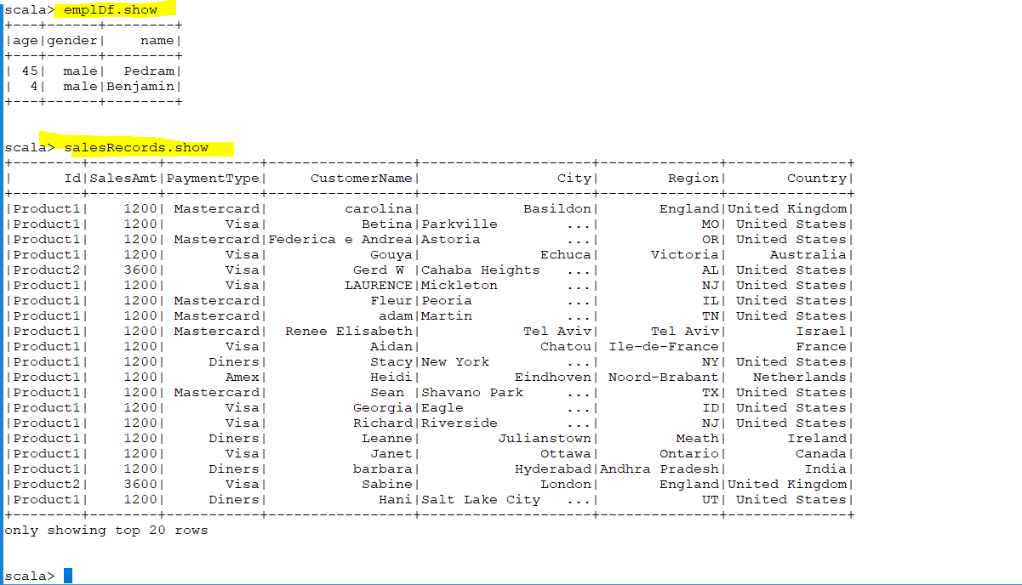

Slide 21
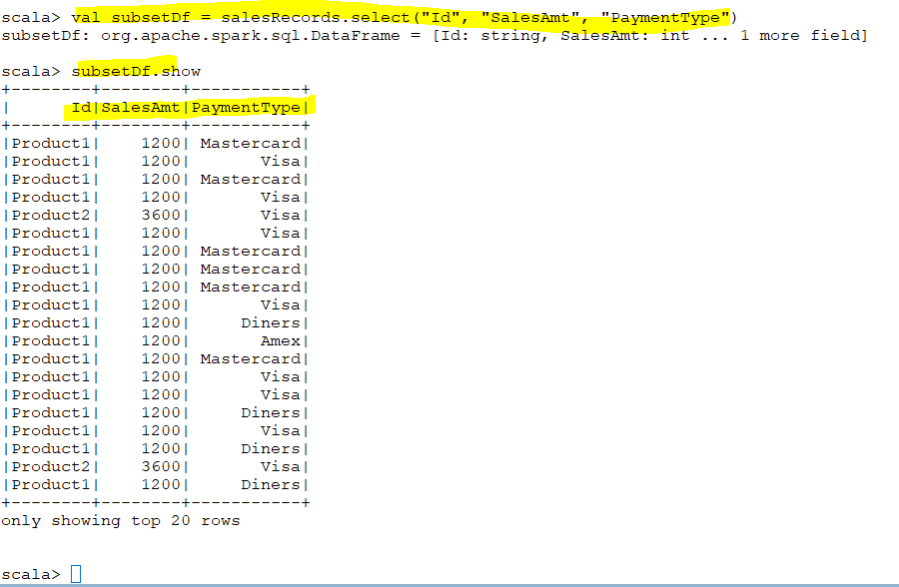
Select
Notes:
Select

Slide 22
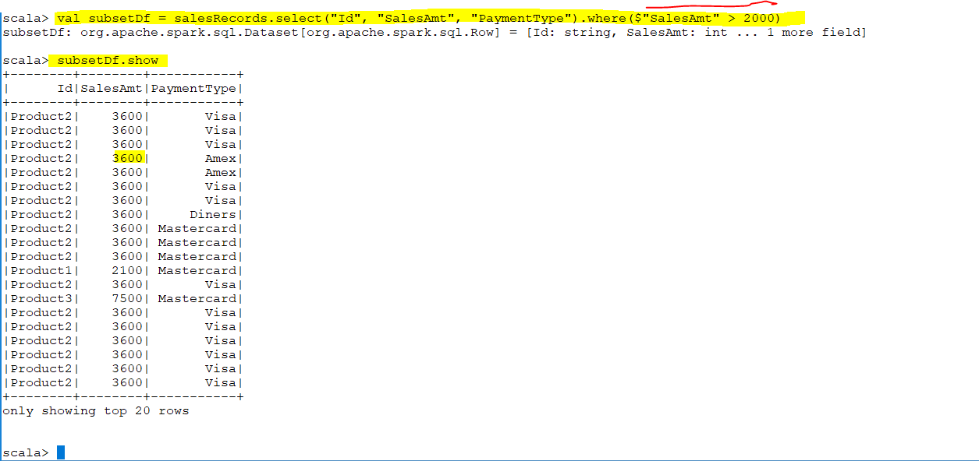

Slide 23
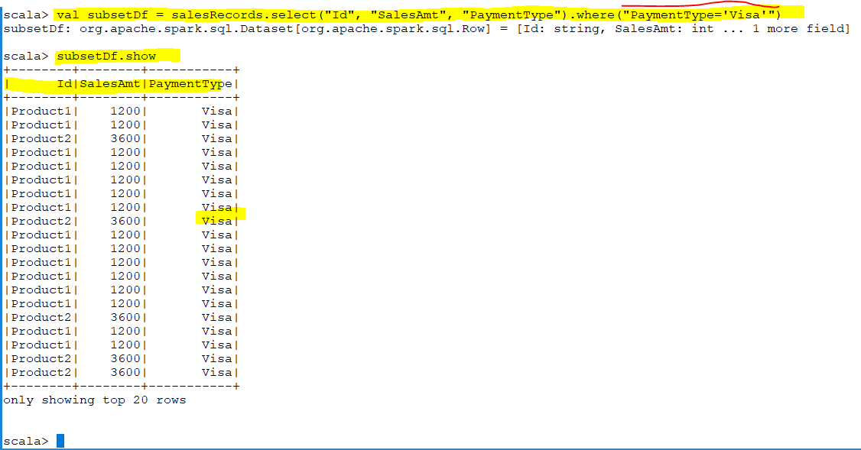

Slide 24
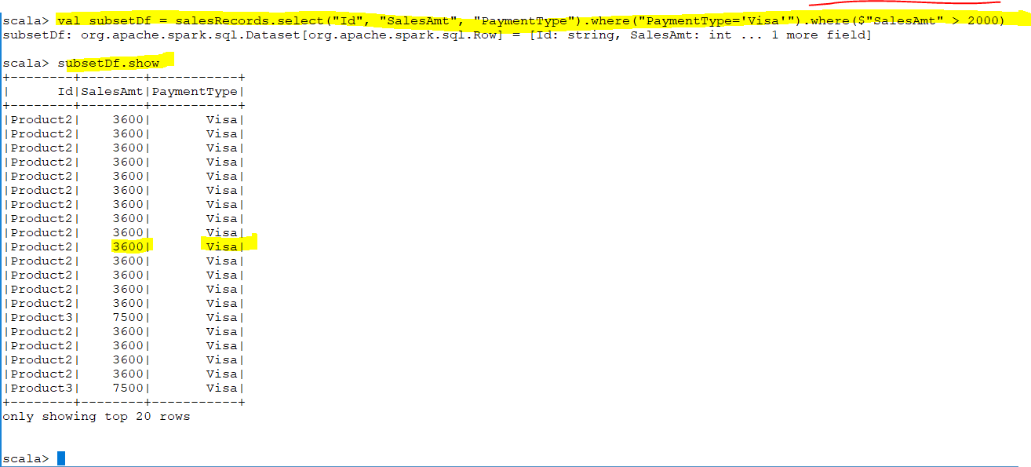

Slide 25
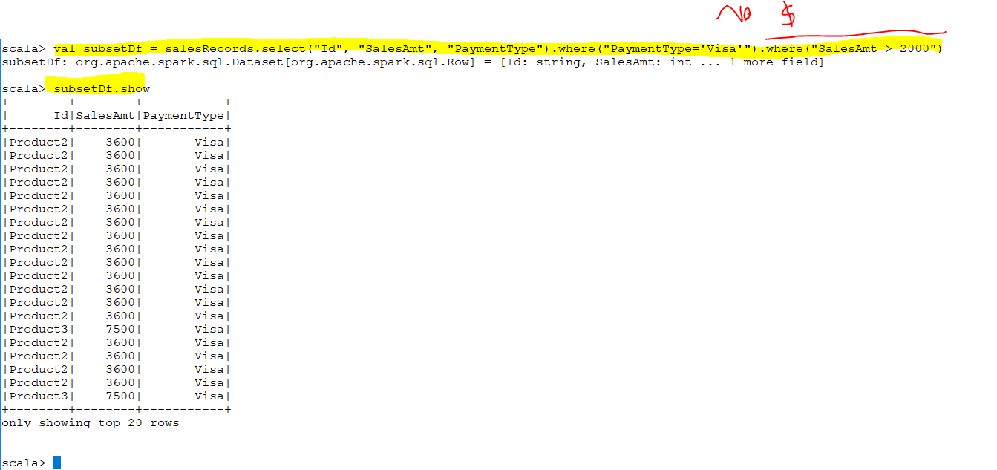
Every “.” return me a new DataFrame

Slide 26
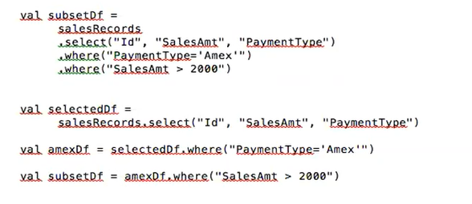
Every “.” return me a new DataFrame

Slide 27
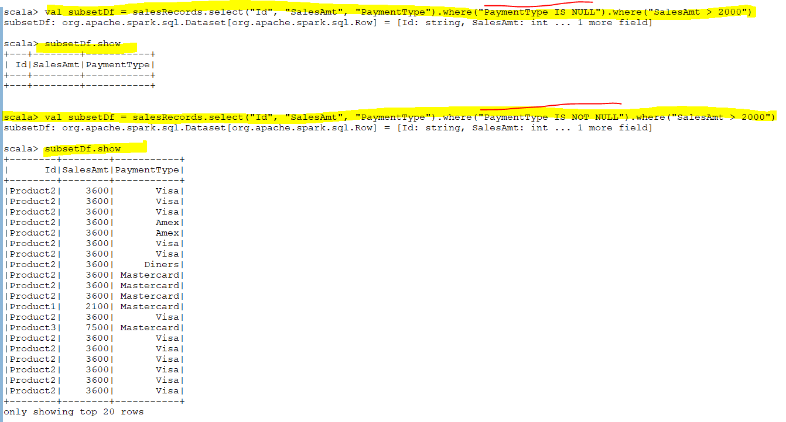

Slide 28
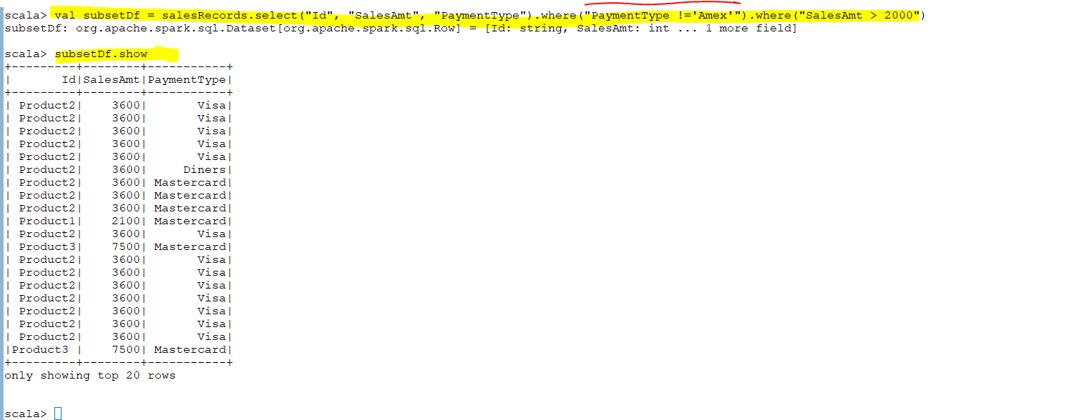

Slide 29
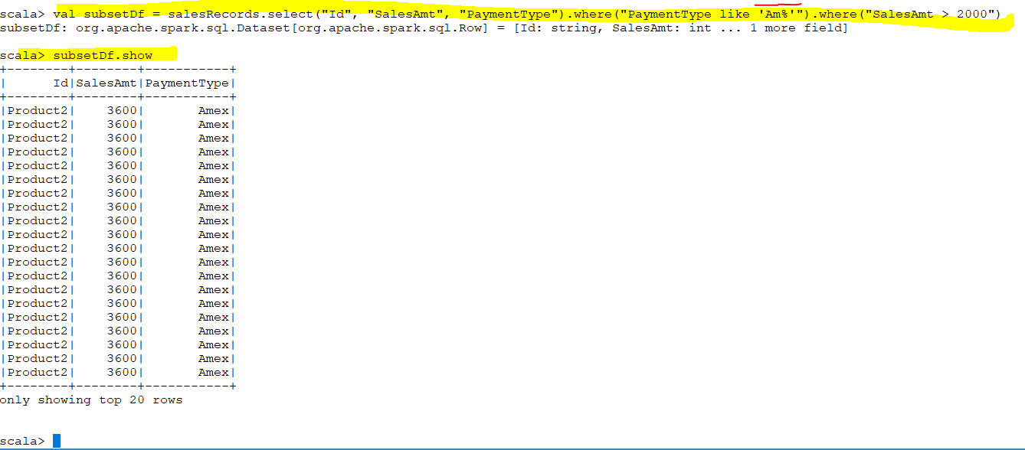

Slide 30
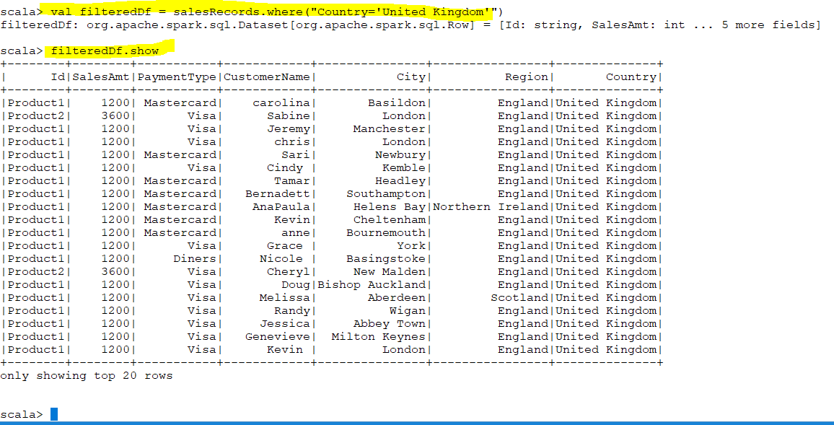
Filter

Slide 31
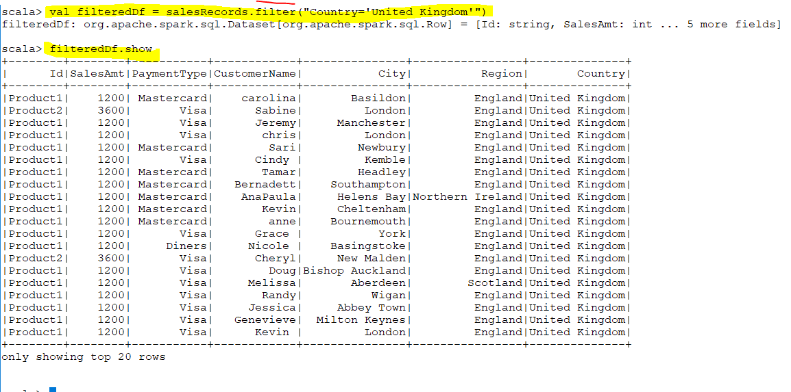

Slide 32
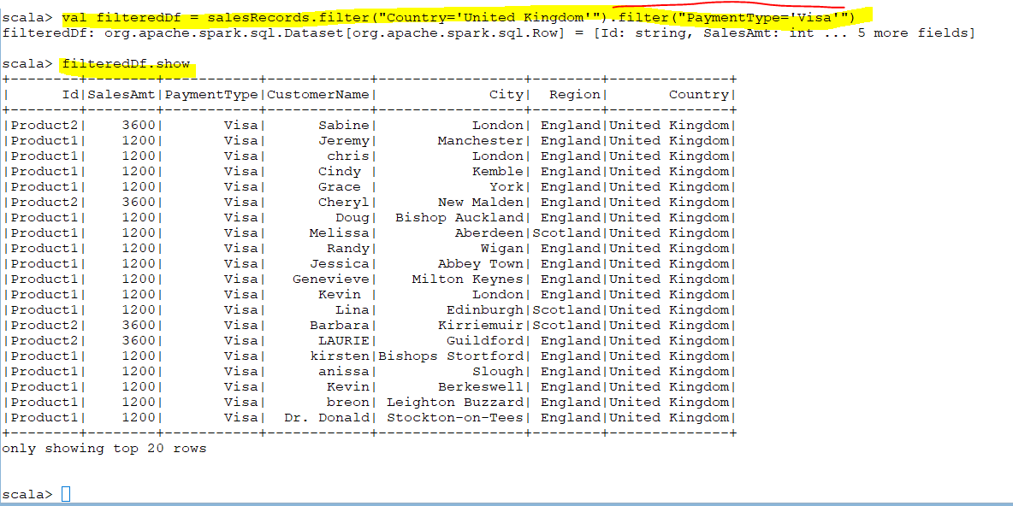

Slide 33
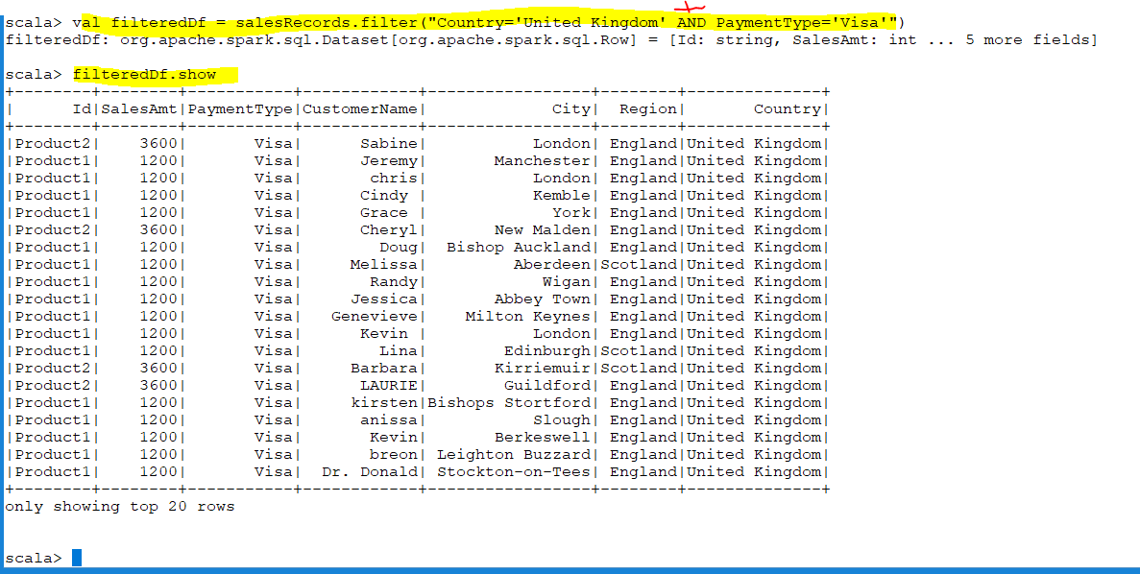
Notes:
This is the better way

Slide 34
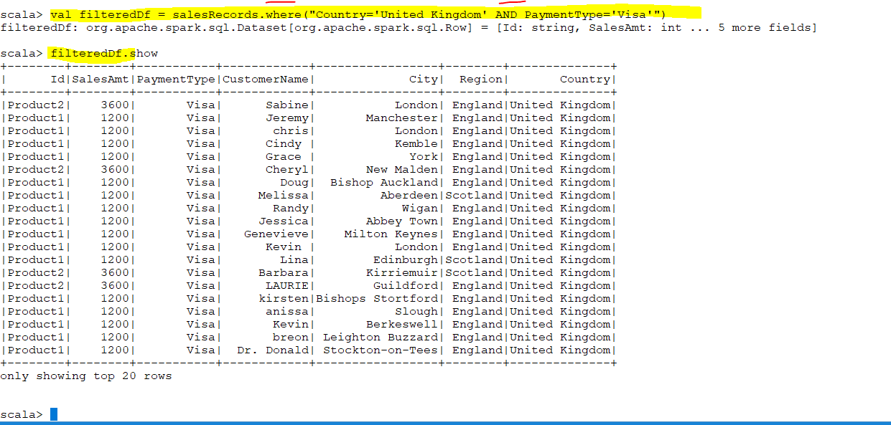

Slide 35
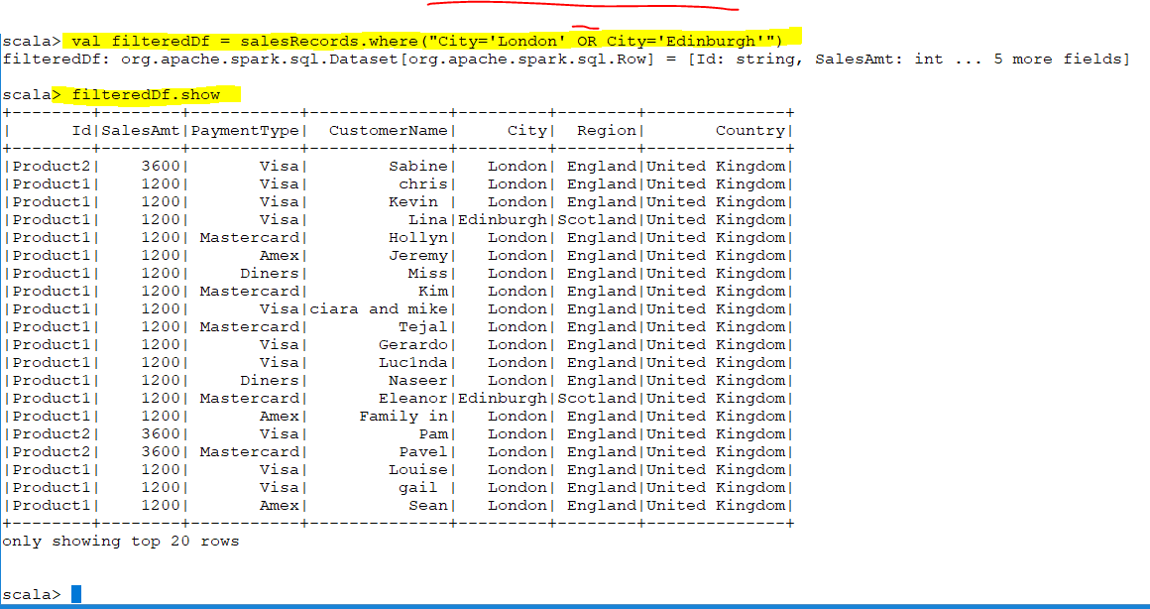

Slide 36
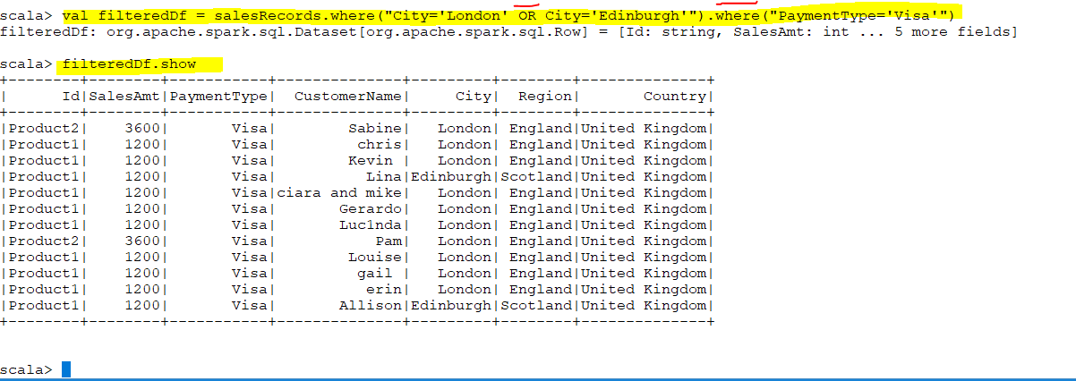
Notes:
filter is simply the standard Scala name for such a function, and where is for people who prefer SQL

Slide 37
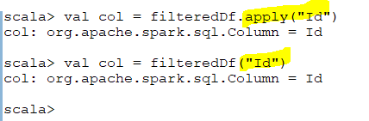
alias
Apply
Apply returns col object .You can use it without apply

Slide 38
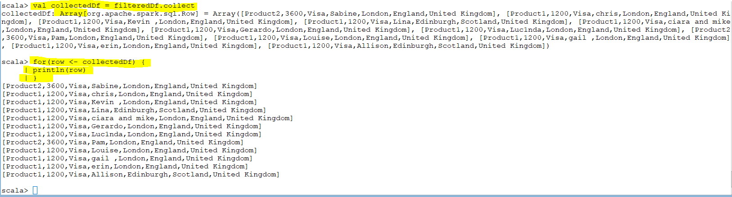
Collect
Collect gives array of row objects

Slide 39
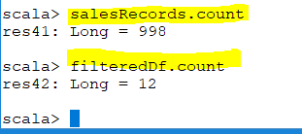
Count
Notes:
count

Slide 40
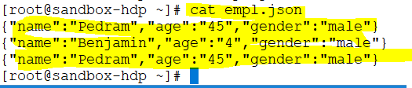
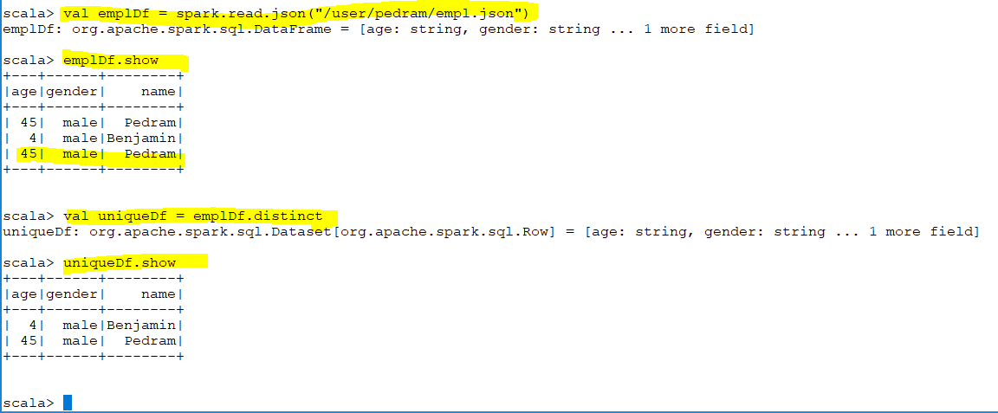
Distinct
Notes:
Distinct

Slide 41
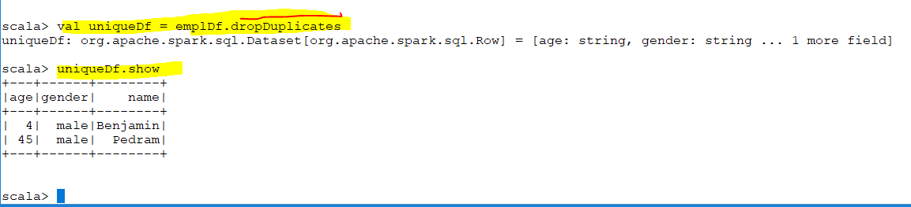
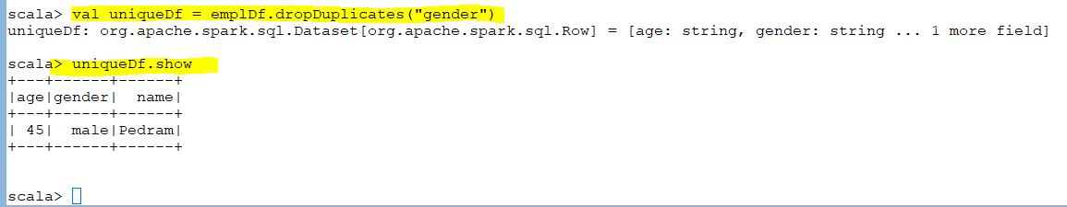
Drop Duplicate
Notes:
Drop Duplicate

Slide 42
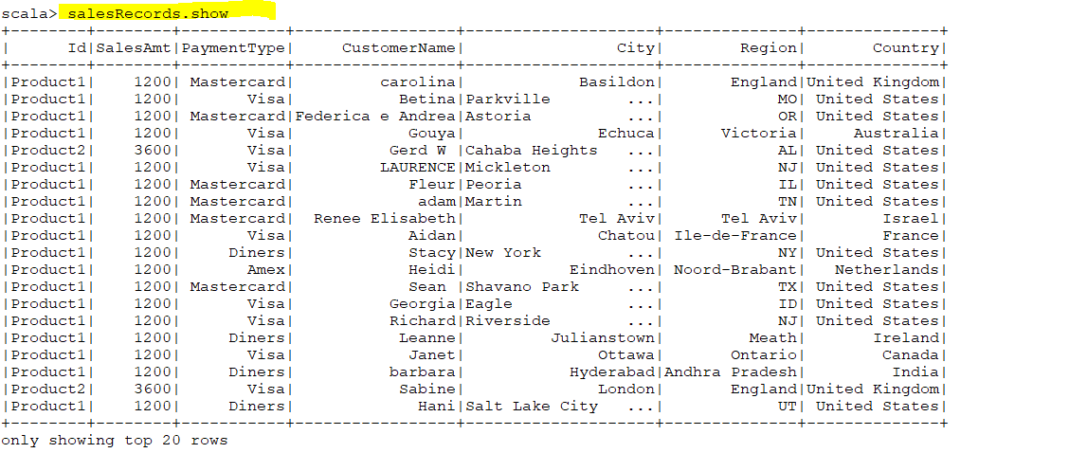
Filter function
Filter function : we use when is complicated condition because you can not use typical sql stuff that’s why we write the filter function
Notes:
The function is pass the particular row and then you do row.(methods) to get the value of particular row

Slide 43
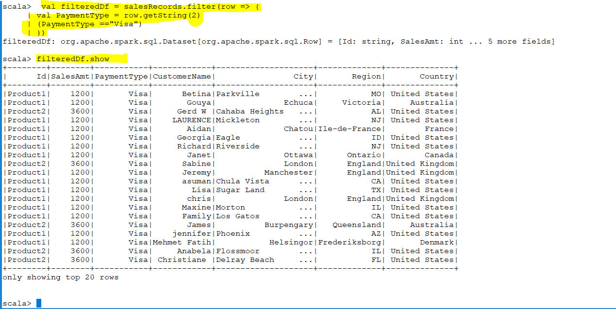

Slide 44
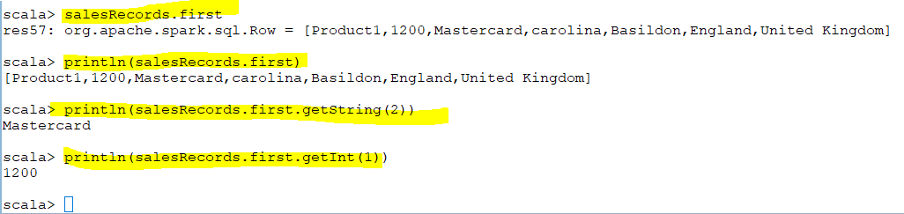
First
Notes:
First

Slide 45
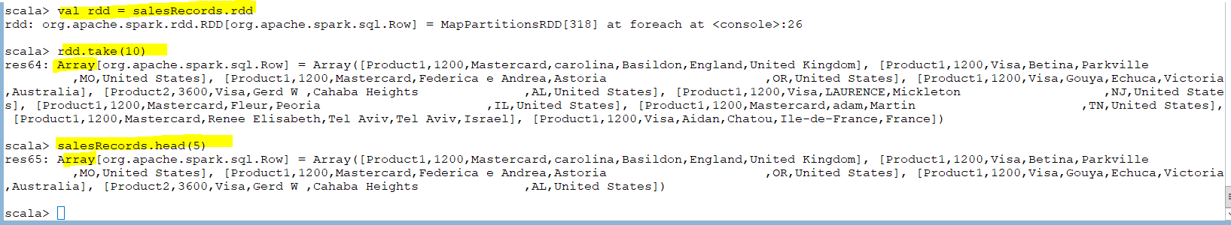
Take and Head

Slide 46
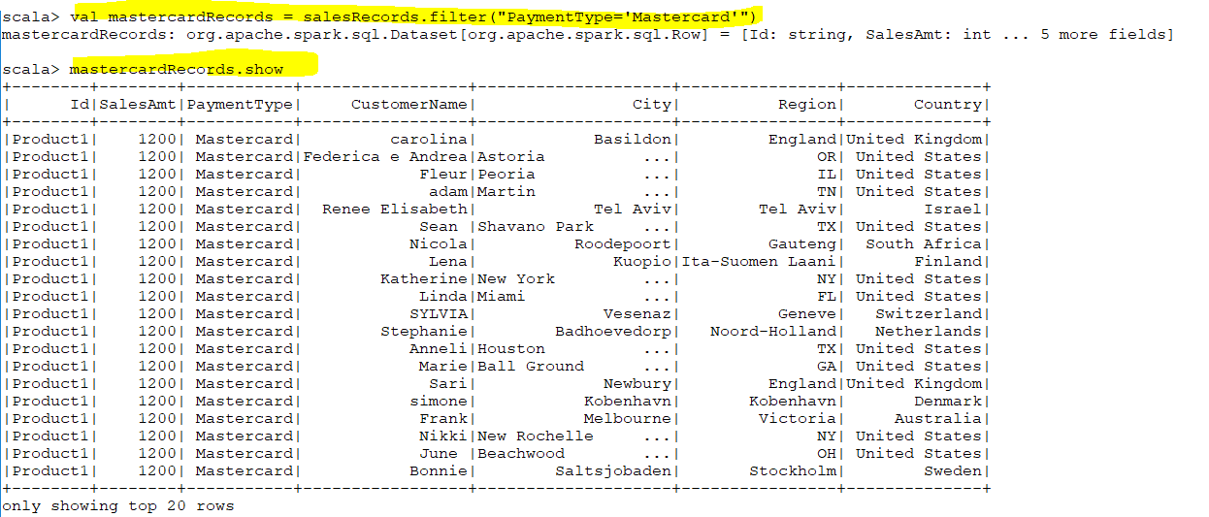
Intersection
Notes:
union

Slide 47
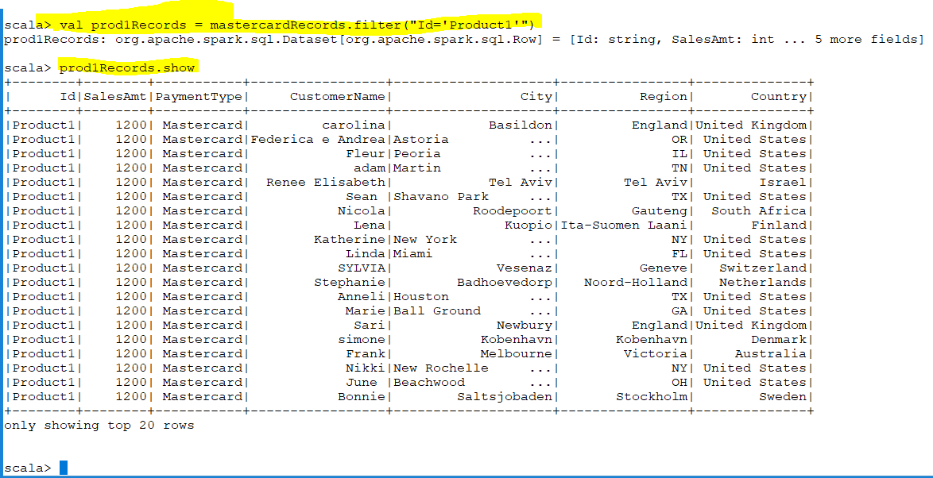

Slide 48
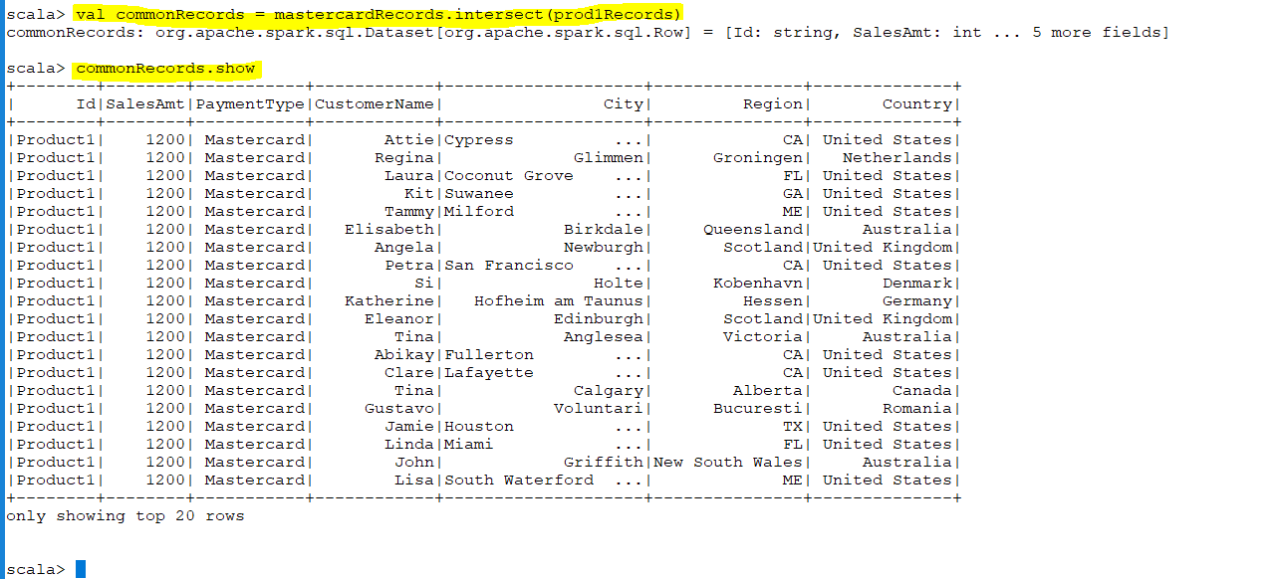

Slide 49
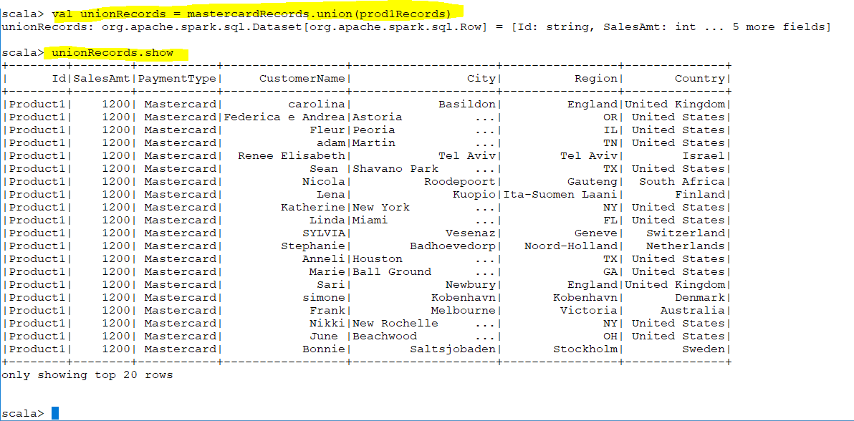
union
Notes:
union

Slide 50
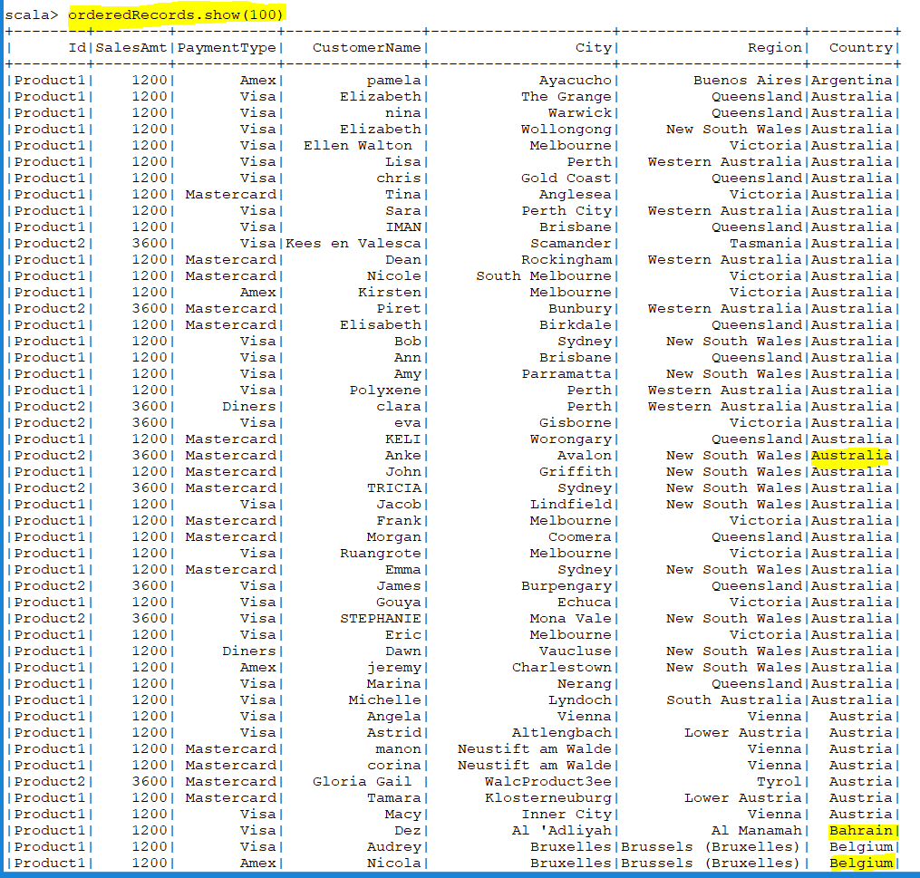
OrderBy
Notes:
orderBy

Slide 51
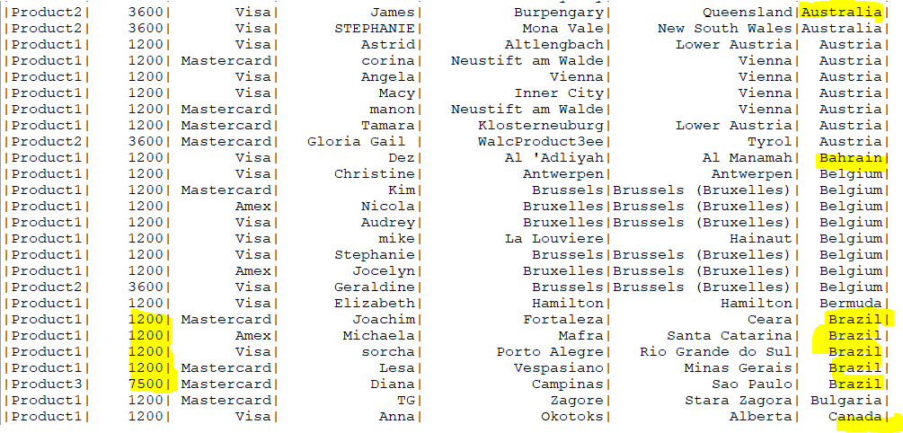
Notes:
We can do two column .
It will order first y country then within the country it will order by salesamount

Slide 52
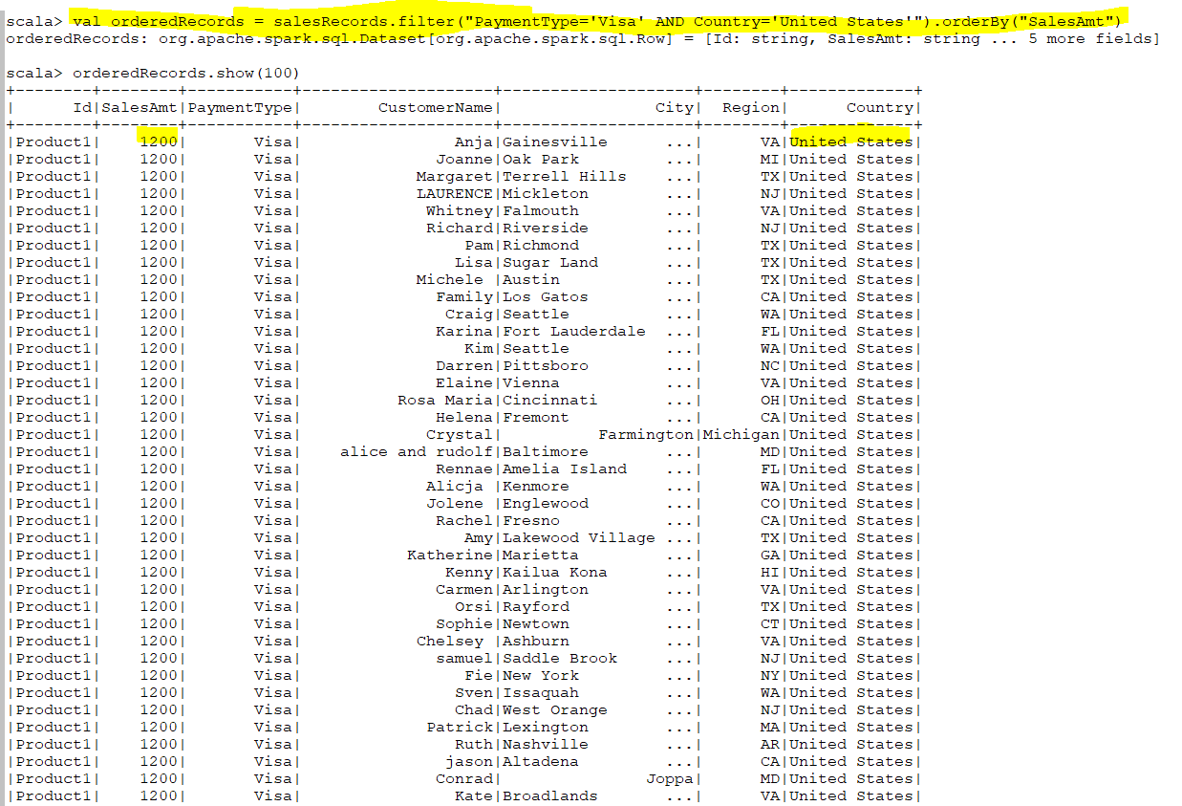

Slide 53
Cover to Jason
Notes:
jsonRecords.foreach(row => println(row))
Sometimes converting the RDD to json is usefull

Slide 54
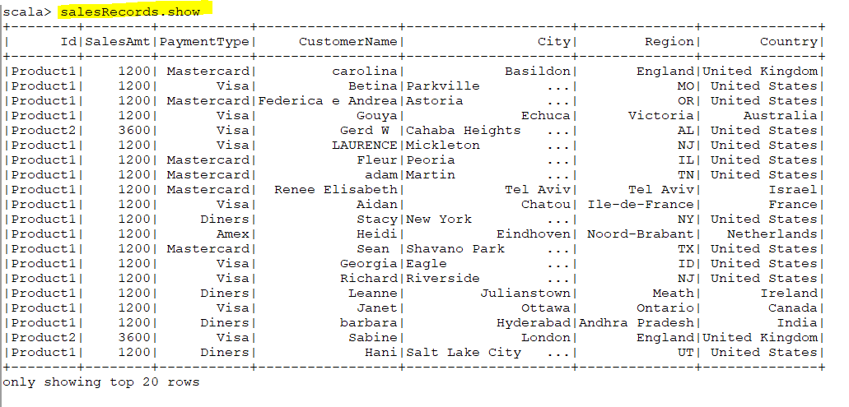
CreateOrReplaceTempView
Notes:
createOrReplaceGlobalTempView

Slide 55
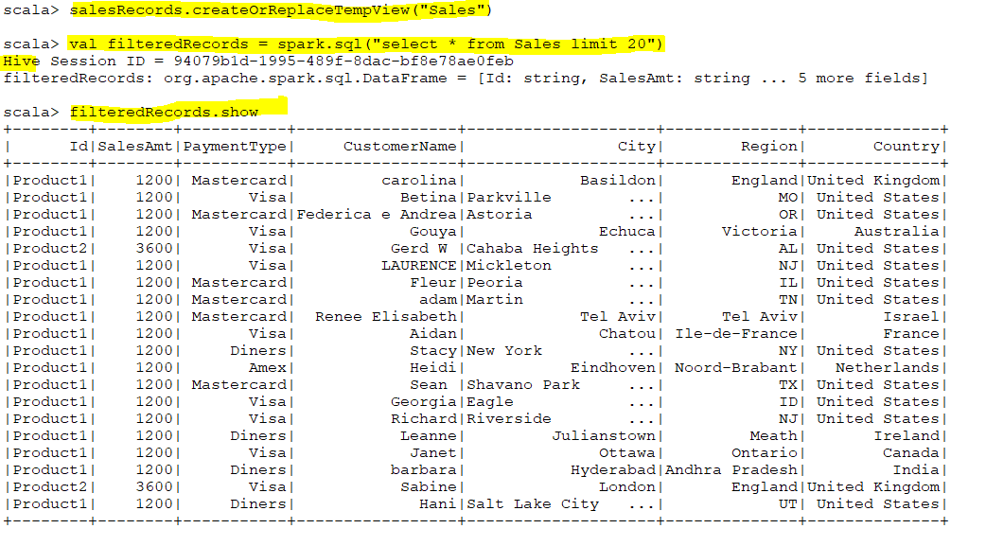
Notes:
creates (or replaces if that view name already exists) a lazily evaluated "view" that you can then use like a hive table in Spark SQL. It does not persist to memory unless you cache the dataset that underpins the view.

Slide 56
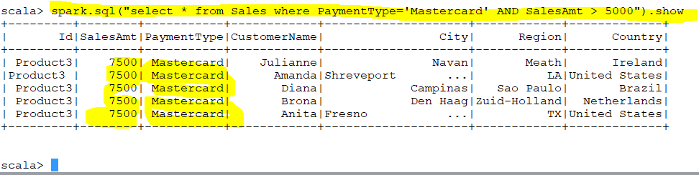
Notes:
spark.sql("select * from Sales where PaymentType='Mastercard' AND SalesAmt > 5000").show

Slide 57
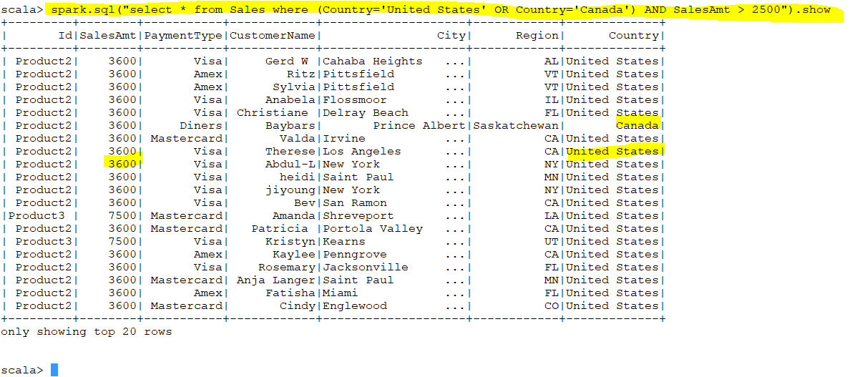
Notes:
spark.sql("select * from Sales where (Country='United States' OR Country='Canada') AND SalesAmt > 2500").show

Slide 58
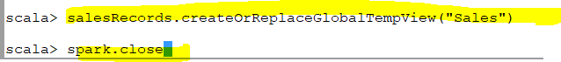
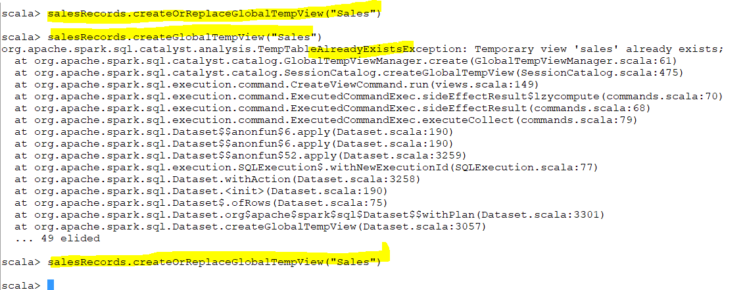
createOrReplaceTempView vs createOrReplaceGlobalTempView
Global view available to all sessions even we close the current session
createGlobalTempView :The view is not exist and we just creating that. we will receive an error if it exist
createOrReplaceGlobalTempView : It will overwrite the existing view if it exist
createTempView : The view is not exist and we just creating that we will receive an error if it exist
createOrReplaceTempView : It will overwrite the existing view if it exist
Notes:
Each spark program establish a spark session
When you create tempview you create for only this session however when you create globalview its available for all session
Global view available to all sessions even we close the current session

Slide 59
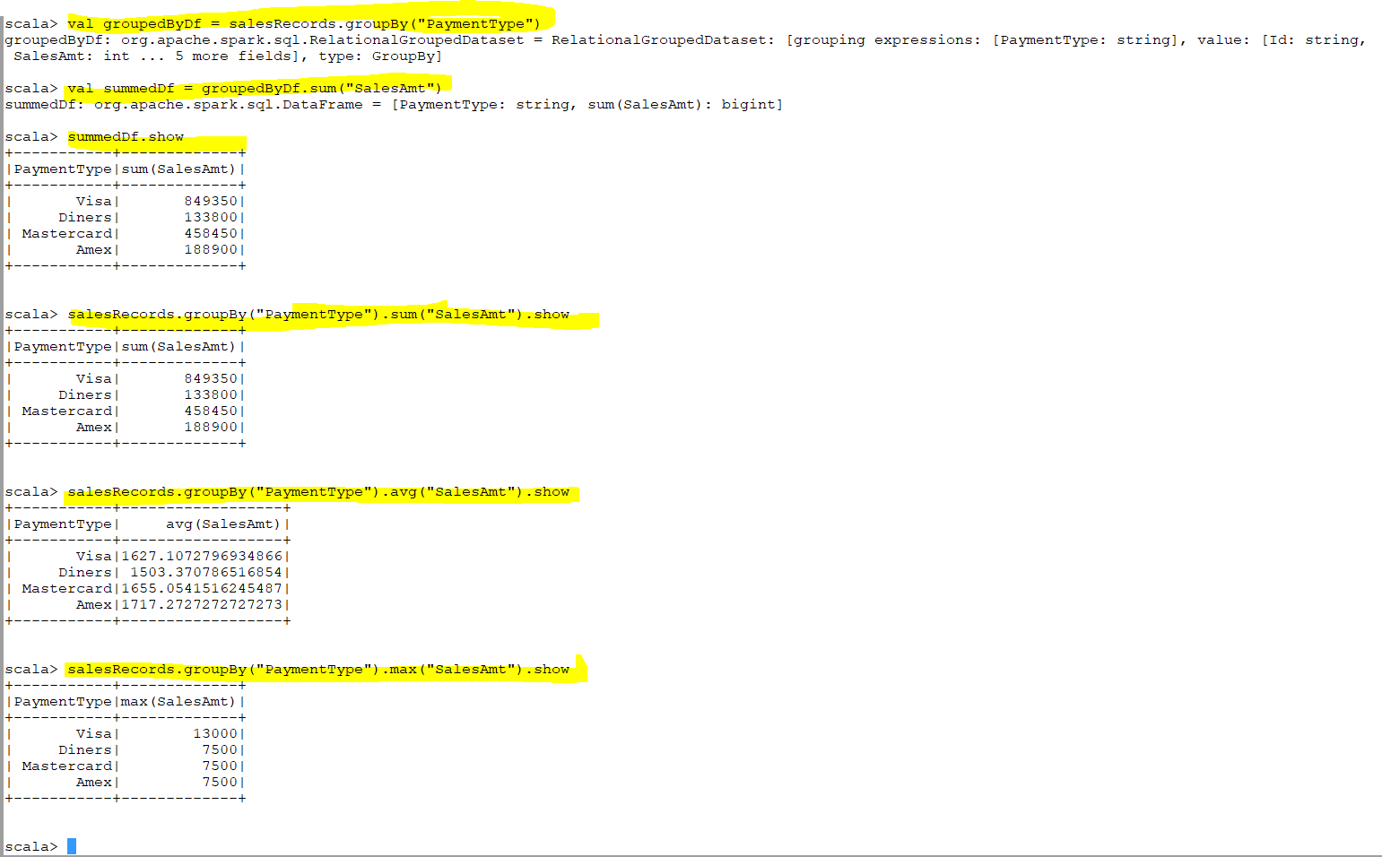
groupBy

Slide 60

Count
Notes:
count

Slide 61
Run SQL on Files
Instead of loading a file into a dataset and selecting columns, we may run sql directly on the file:
val salesRecords = spark.sql("SELECT * FROM csv.`/Users/hdpuser/DocumentsSalesJan2009.csv`")

Slide 62


spark.sql("Select)
We apply sql on the file directly not in the data frame
Notes:
val salesRecords = spark.read.format("csv").option("header", true).option("inferSchema", true).load("/user/pedram/SalesJan2009.csv").select("Id", "PaymentType", "SalesAmt").show
spark.sql("Select _c0, _c1, _c2 from csv.`/user/pedram/SalesJan2009.csv`").show
You can run “spark.sql("Select “ instead
We apply sql on the file directly not in the datafram
Csv means the csv file to use

Slide 63

Apply in file rather than the data frame

Slide 64

Spark.sql
The entire things happening in memory .We do not have any db
Every thing happening in memory .Spark is In memory db .Any thing you do in any db you can do it here too.
Notes:
Spark.sql

Slide 65



Slide 66
Write Data
The write functions are quite similar to the load functions
The following will write the contents of the “salesRecords” dataset in the default format:
salesRecords.write.save(“/Users/hadoop-user/Documents/output”)
To write using in a specific format, either change the default format or specify the format, like:
salesRecords.write
.format(“csv”)
.save(“/Users/hadoop-user/Documents/output”)
Like in read, options, applicable to the specific data source, can be specified:
salesRecords.write
.format(“csv”)
.option(“header”, true)
.save(“/Users/hadoop-user/Documents/output”)

Slide 67


Get dataframe write by .write.save
We were doing read on session object .(spark.read.load).Here we are doing on the data frame not spark session
The write object is derived from data frame.The reader object is derived from session object (spark session)

Slide 68

Notes:
val salesRecords = spark.read.format("csv").option("header", true).option("inferSchema", true).load("/user/pedram/SalesJan2009.csv")

Slide 69

Two partition two task two files

Slide 70
Save Mode
SaveMode.ErrorIfExists
SaveMode.Append
SaveMode.Overwrite
SaveMode.Ignore

Slide 71

SaveMode.Append

Slide 72
SaveMode.Overwrite

Slide 73
SaveMode.Ignore

Slide 74
Read & Write Hive Tables
Hive support needs to be enabled on spark session
The hive warehouse directory needs to be set as “spark.sql.warehouse.dir”
Once the session is created, SQL statements can be issued using sparkSession.sql(“<sql_statement>”)
Sorting and partitioning can be done on the tables being saved

Slide 75



Derby DB warehouse directory
“spark.sql.warehouse.dir”
metastore directory
hive.metastore.warehouse.dir
Notes:
“spark.sql.warehouse.dir” : Hive has a warehouse directory and within Hive warehouse directory I have DB directory .There could be many DB directory .Within DB directory I creates tables so
I have tables directory so within table directory I can have my data file if my table is partitioned then within the table directory I will have partition directory.
Within partition if I have further sub partitions then sub partition directory and finally there will be a file in any specific format like text parquet ,orc ,…
This is the structure .Whenever we enable Hive support we point to particular Hive installation.
This Hive installation has their own metastore directory which is pointed to hive.metastore.warehouse.dir
We do not have real Hive installing on our machine so we run in IDE . If I am running in the cluster then I will pointing to the Hive installation so I provide the warehouse directory location
But I do not have it so I need to at lease provide metastore so spark provide inbuild derby DB like Hive default
The Derby DB warehouse directory is pointed to by “spark.sql.warehouse.dir” .
Create database if not exists sales_db: If remove sales metadata from the metastore and from warehouse directory (Hive has two part meta data and data .Metadata is in the metastore and data is in the file system so the actual data is in “C:/Users/pedro/Documents/test_data/hive” )
salesDf.write.mode(SaveMode.Overwrite).format("parquet").partitionBy("Country").saveAsTable("sales") :
.config("spark.sql.warehouse.dir", "C:/Users/pedro/Documents/test_data/hive") : If you have installed Hive then you use it
=================================================================================
package pedramsparksql
import org.apache.spark.sql.SparkSession
import org.apache.spark.sql.SaveMode
object HiveExample1 {
def main(args: Array[String]) {
val sparkSession = SparkSession.builder
.appName("spark-hive-example")
.master("local[*]")
//.config("spark.sql.warehouse.dir", "C:/Users/pedro/Documents/test_data/hive")
.enableHiveSupport()
.getOrCreate()
val salesDf = sparkSession.read
.option("inferSchema ", true)
.option("header", true)
.csv("C:/Datasets/SalesJan2009.csv")
sparkSession.sql("Create database if not exists sales_db")
sparkSession.sql("use sales_db")
//sparkSession.sql("drop table if exists sales")
salesDf.write.mode(SaveMode.Overwrite).format("parquet").partitionBy("Country").saveAsTable("sales")
}
}

Slide 76




Slide 77
Save as Hive Table
Dataframes can be saved as Hive tables using the saveAsTable function
If no Hive metastore exists, a table is created in the default Derby database
Even if the SparkSession is closed, the table metadata is retained as long as the Derby session remains active

Slide 78
RDD to Dataframe
An RDD can be converted a dataframe using a Java bean class as follows:
val df = sparkSession.createDataFrame(rdd, beanClass)

Slide 79


Notes:
1) In RRD we deal with structure and semi structure data however in Data frame we deal with structure data. The reason is in RDD we deal with particular line or record for example if we are dealing with tweeter we are dealing with particular twit .In RDD that’s a line .(A twit is a line) but we can not deal with tweets in Data Frame.
2) Data Frame run on specific engine of spark environment. That engine called catalyst engine.
With spark 2 ,they have provided very optimized catalyst engine.(excellent and very powerful, very fast and efficient way of processing of structured data which RDD do not have
So if you have structure data and you want to choose between RDD and Data Frame you choose data frame because it is faster. Your RDD processing will be slower.
Because the catalyst engine is very optimized . The idea is to deal with data through spark sql module .That means converting to the Data Frame and then deal with it and process it.
There might be certain data which are not exactly structured. You need to give it the structure and convert it then deal with that data.
So you need to give the structure ,convert it to data frame and process it because of catalyst engine so some time we prefer to convert RDD to data Frame and then process it.
For example: Facebook post is unstructured data so if you have a method to parse your data and take it to some sort of structure data (like word count) which particular topic is trending in Facebook ?
So in this case we pass each word and see the number of occurrence and then to overall number of occurrence and see which word is presented in the topic .
So we need to associate a schema to it. Give RDD a schema
We use case class object for schema purpose.
. The case class defines the schema of the table.

Slide 80

Notes:
I need spark context object to load a file in rdd “textFile("C:/Datasets/SalesJan2009.csv")”
To load a data frame we need spark session
Field(0) means productid ,I pass that to the primary constructor Sales
============================================================================

Slide 81

Convert RDD to DF
Notes:
Rdd.toDF : Convert RDD to DF

Slide 82




Slide 83


We need to remove the first line in csv which is header

Slide 84


Slide 85



Slide 86


Notes:
We run “import sparkSession.implicits._” to be able to do rdd.toDF() .If we do not import it we will get error. Why we did not do on the top ?

Slide 87

Spark session is an object so if we put it on the top we get an error.
We should do it after spark session is created.

Slide 88

With The Column Example
Notes:
We process trade data and put data in hdfs .for every day of data we process we create a folder with date . Like 13042019
That’s basically partitioning a data to the current date.
The input data may or may not have today’s date.so we need to create a column on top of the data frame which we already converted
.read : gives df reader object

Slide 89

Run without ‘with column”
Notes:
Run without ‘with column”

Slide 90


Slide 91



Notes:
Literal is something which is contains in the functions package
“SimpleDateFormat” is a formatter.It takes the Date object .Format it to “yyyy-MM-dd” format.
getFormattedDate(new Date)) :Returns me a string

Slide 92

Lit : It create column object out of it

Slide 93

It creates a new column

Slide 94

If I run it tomorrow I should have it 2019-04-13
Why we need the current date ? Because we need to partition the data

Slide 95


Slide 96



